Slide 1

Metr4901 – Thesis Seminar
Callum Rohweder
(Virtual) Robotics and Experimental Platform

Slide 2
Scope
Using V-REP’s remote API, a simulated environment of a test laboratory with a Jaco Kinova arm can be generated, and movement replicated in the physical space
User input
Virtual Manipulation
Physical Manipulation

Slide 3
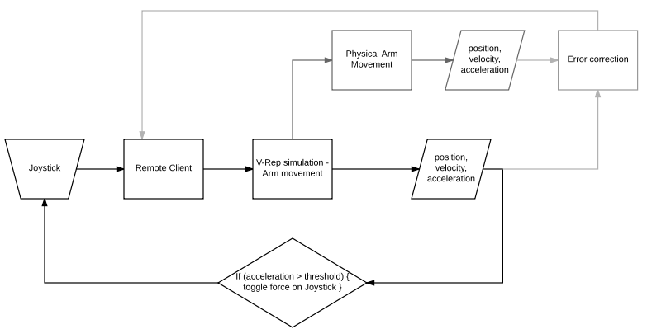
Purpose
Simulation before implementation

Slide 4
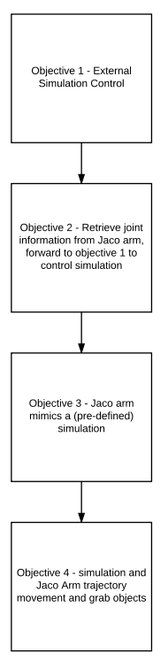
Objectives
Remotely control a Jaco arm simulation in VREP (forward kinematics)
Move point to point (inverse kinematics)
Later: physical arm mimic’s remote simulation, controlled by user inputs

Slide 5
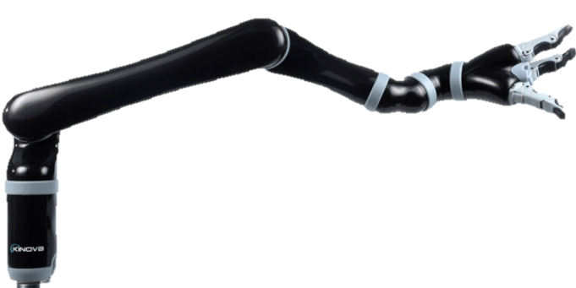
User Inputs
Keyboard Commands
Joystick
Mouse click

Slide 6

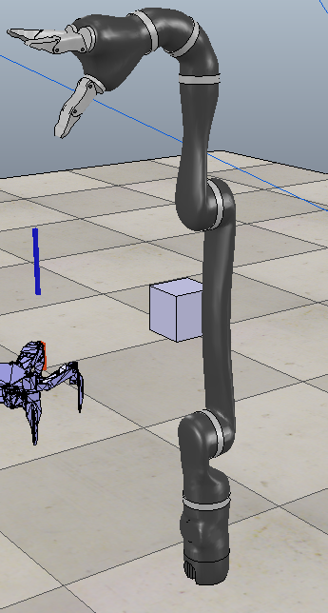
V-rep
Manipulation and physical simulation of objects in a scene
Actuation and sensing processes defined in code
Remote API (C, Python, Matlab, Java, Octava, Lua and Urbi)
Different function calls (blocking / non-blocking / data streaming)

Slide 7
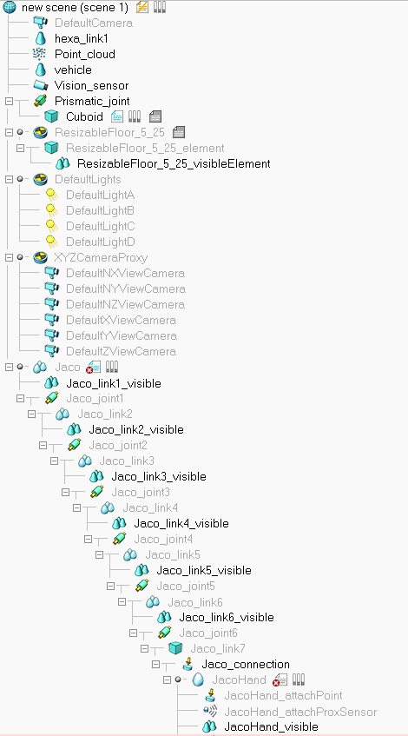
Scene Hierarchy
Can place sensors at any location
Each parent object has an embedded Lua script
Joints can have different behaviours
Passive move – fixed link
Inverse Kinematics Mode Dependent Mode - to another joint’s angle
Torque and Force Mode (PID or damping)

Slide 8
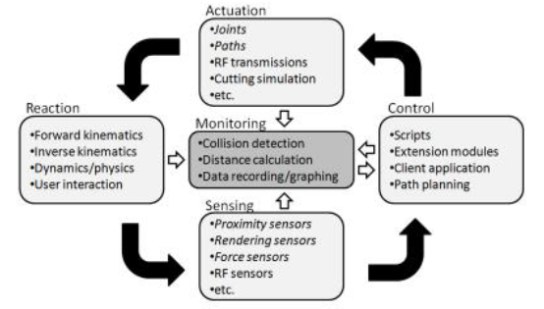
VREP Simulation
Objects can be imported models or created
Physics engines allow interaction of objects

Slide 9
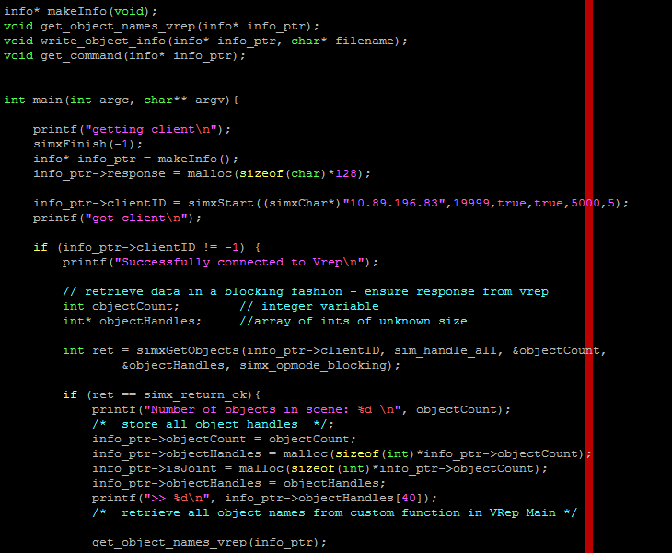
Setting up A Remote client
Python script for testing VREP functions
Client program in C
Executed in Linux & Windows

Slide 10
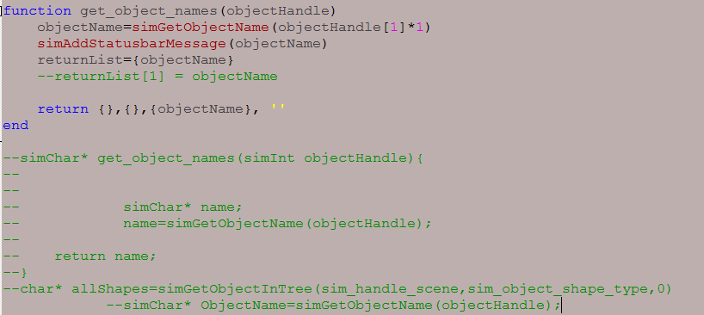
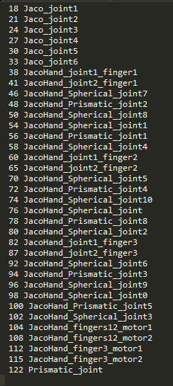
Setting up A Remote client
Custom embedded scripts

Slide 11
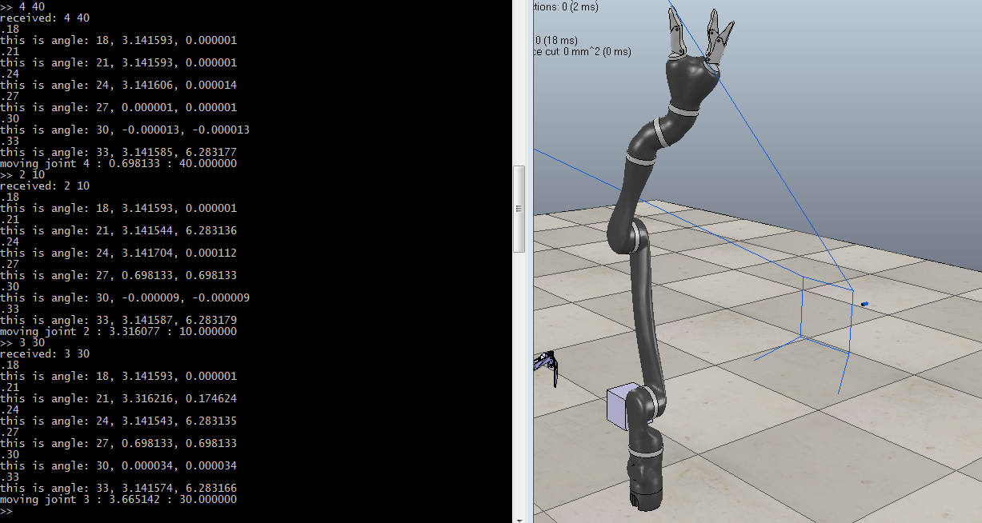
Remote Client
Input joint number and angle

Slide 12
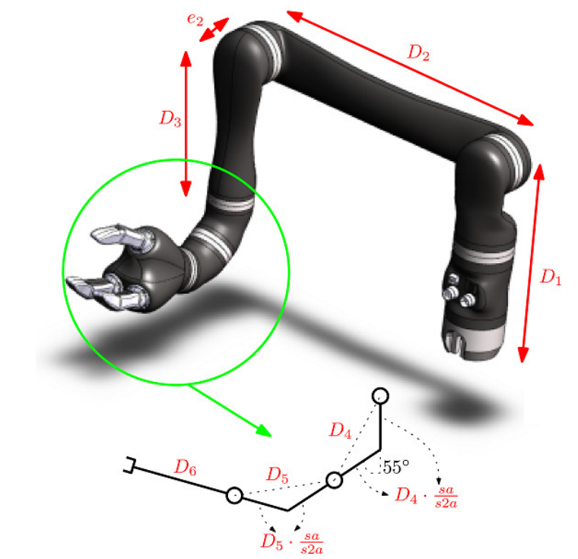
Forward Kinematics
Need to get hand position in space
Allows joint angles for motion to a new point to then be calculated using Inverse kinematics

Slide 13
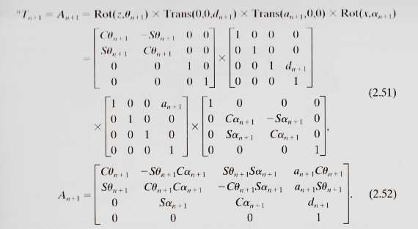
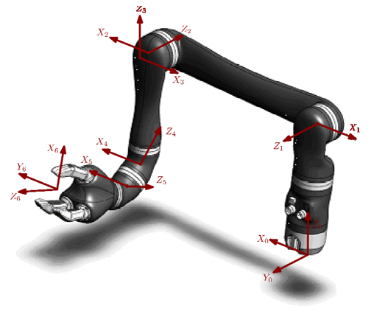
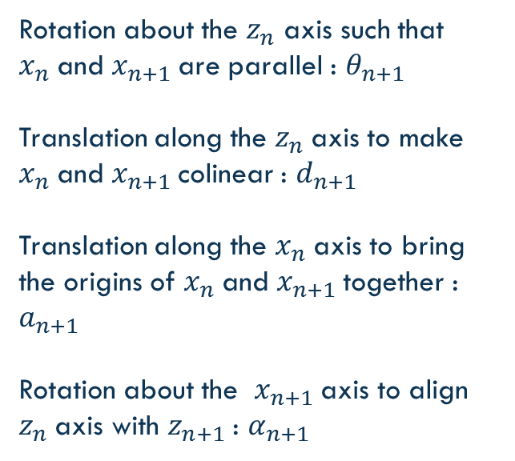
Transformation
Rotation about the $z_{n}$ axis such that $x_{n}$and $x_{n+1}$are parallel : $θ_{n+1}$
Translation along the $z_{n}$axis to make $x_{n}$and $x_{n+1}$colinear : $d_{n+1}$
Translation along the $x_{n}$axis to bring the origins of $x_{n}$and $x_{n+1}$together : $a_{n+1}$
Rotation about the $x_{n+1}$axis to align $z_{n}$axis with $z_{n+1}$: $α_{n+1}$

Slide 14
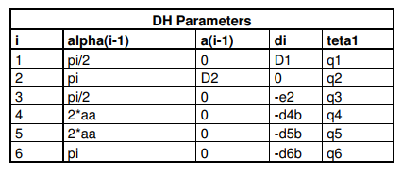
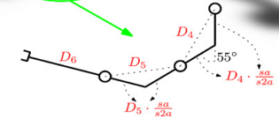
Coordinates

Slide 15
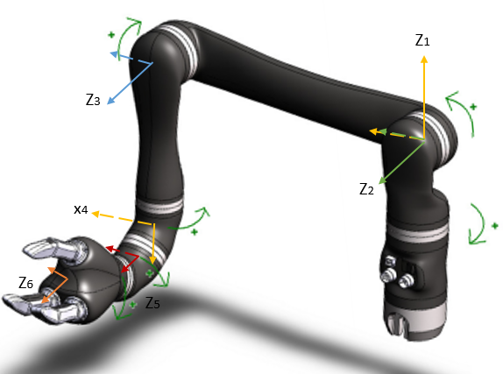
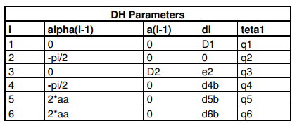
Coordinates

Slide 16
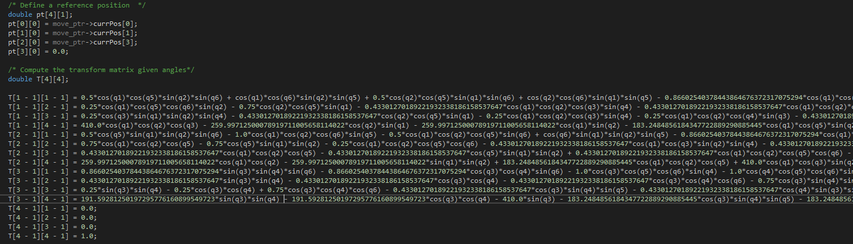
Transformation Matrix
Generated in MATLAB®
Simplified by removing small coefficients

Slide 17
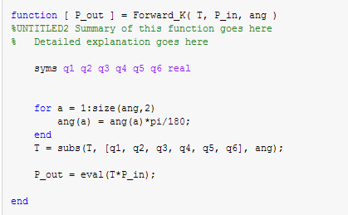
Checking Forward Kinematics
Neither work yet
Need correct initial position and angles for given kinematics solution

Slide 18
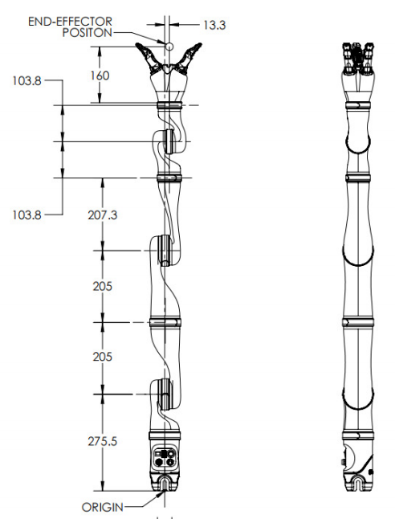
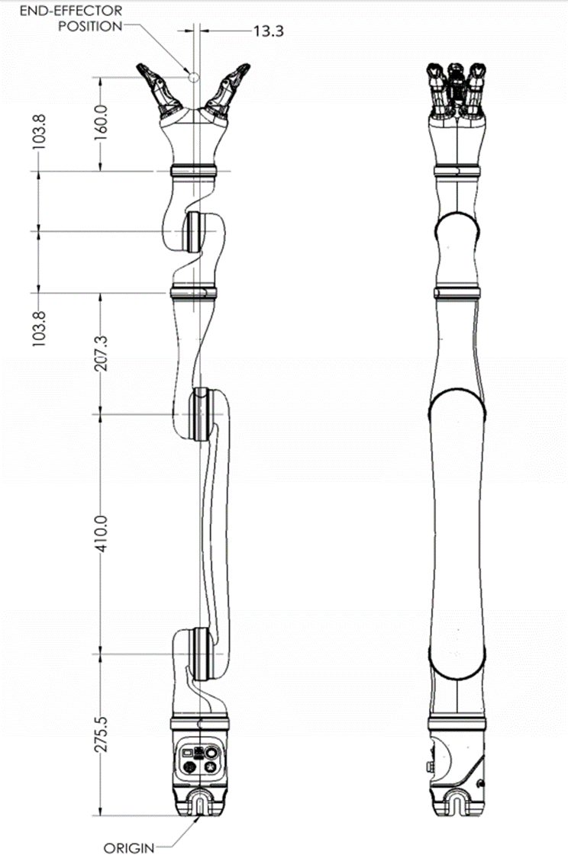
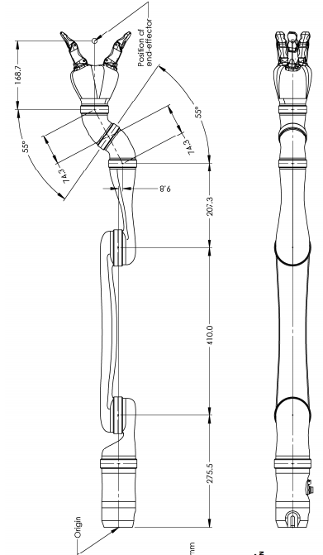

Slide 19
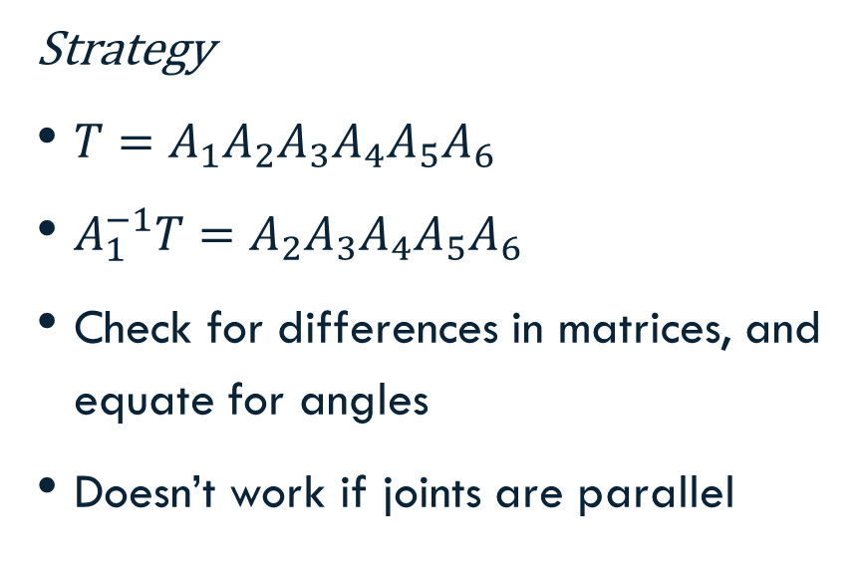
Inverse Kinematics
Strategy
$T=A_{1}A_{2}A_{3}A_{4}A_{5}A_{6}$
$A_{1}^{−1}T=A_{2}A_{3}A_{4}A_{5}A_{6}$
Check for differences in matrices, and equate for angles
Doesn’t work if joints are parallel
Actuality
The matrices are equal in all elements
Double angle theorem, simplifications, deleting small coefficients of each element

Slide 20
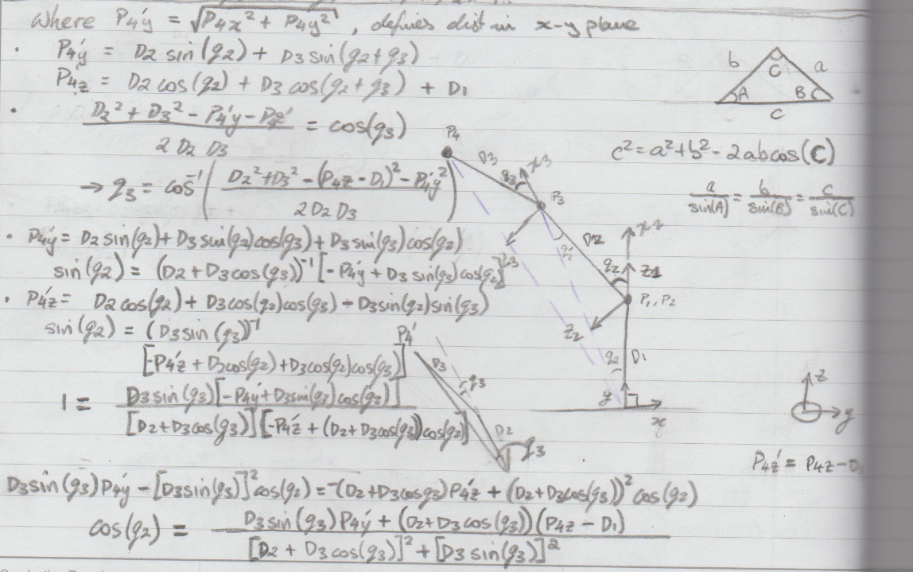
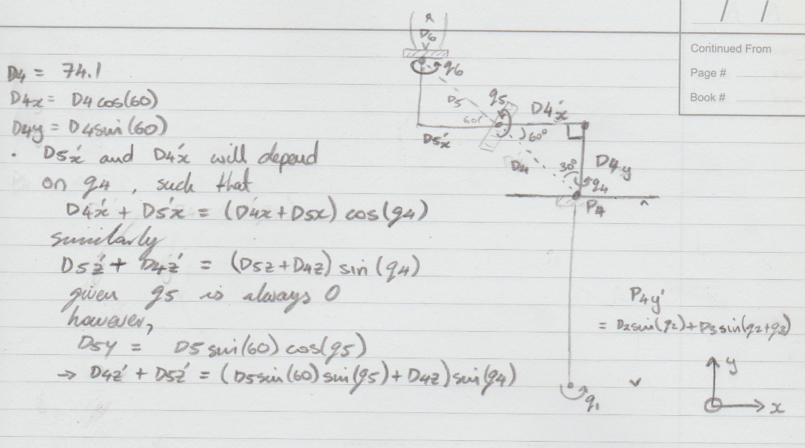
Inverse Kinematics

Slide 21
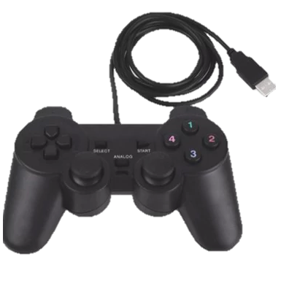
Next:
Get FK and IK working
Implement Joystick
Refine delay

Slide 22
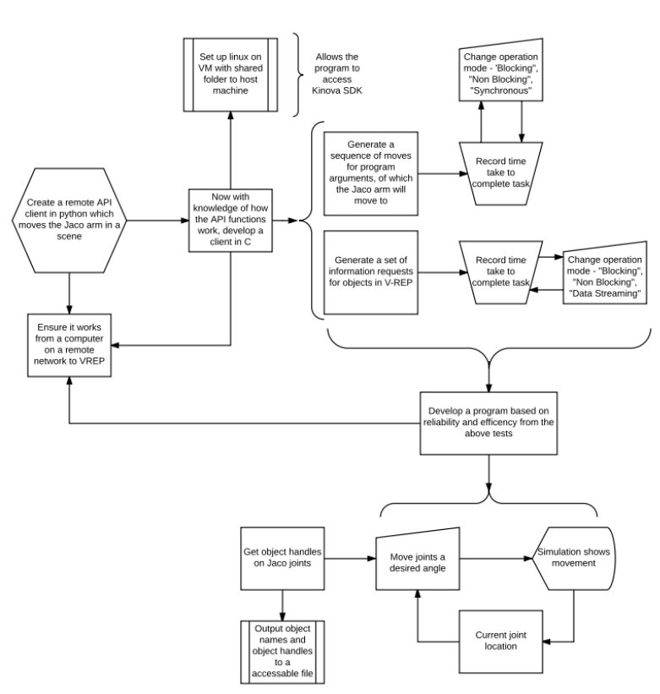
Semester 1 Objectives

Slide 23
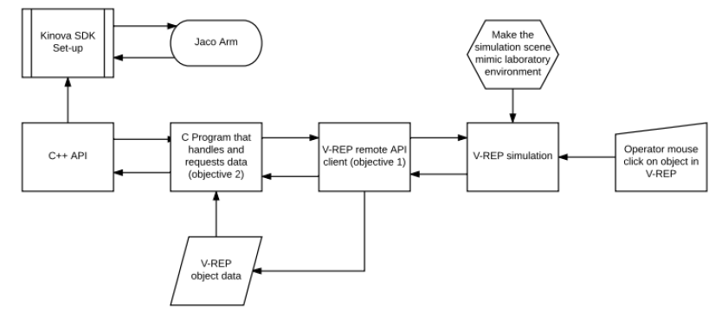
Followed by

Slide 24
Future Uses of Remotely Simulating Robotic Actuators
Optimising or changing manufacturing processes
Laboratory work
Skype call / Virtual learning
Practicing remote surgery

Slide 25
Questions?

